Slide 1
Programming for Non Programmers
Day 1

Slide 2
Who Am I?
Hail To The Victors!
Professionally developing code for over 10 years
Vice President of Engineering for a Startup with Non-Technical Founders
Consultant while building my own Startup

Slide 3
Goals
Be able to “talk the talk” (or at least understand it)
Translate ideas into code
Create basic websites and web apps
Resources for where to go when stuck or to continue learning
Notes:
Will break down each major component of websites so that you’ll be able to understand the context of what’s being discussed
Will get into the process of writing code which will help you take an idea and turn it into a working thing

Slide 4
Who are you?
Name?
Current Profession or Activity?
Ever written any code? What’d it do?
What do you want out of this class?

Slide 5
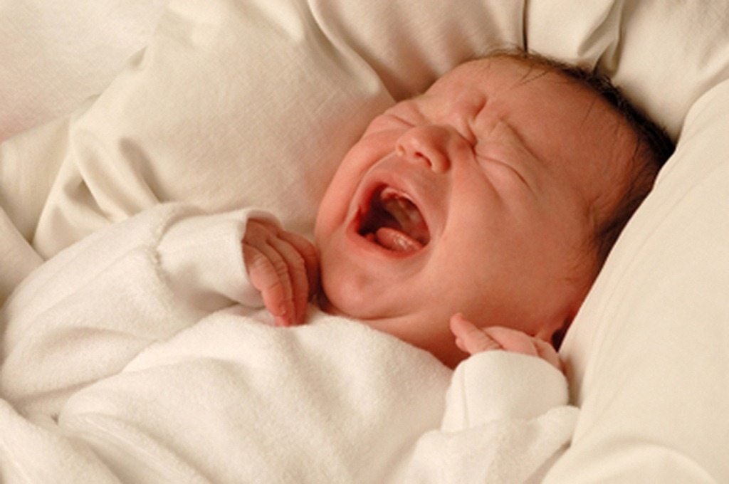

Agenda
Notes:
Ask questions at any point

Slide 6
Agenda
Day 1
Overall Programming Concepts and Terms
Browser Specific Programming Concepts and Terms
HTML
CSS
Build a website!
Day 2
More Overall Programming Concepts and Terms
Server Specific Programming Concepts and Terms
JS
Node.js
Build a web app!

Slide 7
Day 1 Agenda
Programming 101
Servers Vs Browsers
Process of Writing Code
HTML
CSS
Build a Website

Slide 8
Programming 101
What are programs or applications made of?
How do they accomplish a given task?

Slide 9
Programming 101
What are programs or applications made of?
How do they accomplish a given task?
Instructions -> instructions -> instructions -> instructions

Slide 10
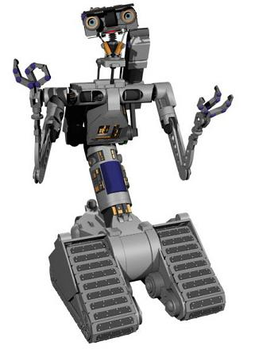

Programming 101
How do I clean my room?
???
Clean My Room!

Slide 11

Programming 101
Pick up toys
Put toys in toy chest
Pick up clothes
Put clothes in hamper
Make bed

Slide 12
Programming 101
Languages are sets of Instructions
Pick up toys
Put toys in toy chest
Pick up clothes
Put clothes in hamper
Make bed
Put pillows on bed
Put stuffed animals on pillows
Pick up books
Put books on shelves
Open toy chest
Close toy chest
Open hamper
Closer hamper
Pick up toys
Put toys in toy chest
Pick up clothes
Put clothes in hamper
Make bed

Slide 13
Programming 101
Programs are ordered sets of Instructions to accomplish a task
Open toy chest
Pick up toys
Put toys in toy chest
Open hamper
Pick up clothes
Put clothes in hamper
And so on…
Pick up toys
Put toys in toy chest
Pick up clothes
Put clothes in hamper
Make bed

Slide 14
Programming 101
Let’s run a Program!

Slide 15
Programming 101
Exercise
In pairs, let’s draw a picture!
1 Programmer and 1 Computer
Programmer is giving instructions
Computer is executing instructions
1 pen per pair
Programming Language
Pick up pen
Put pen down
Stop pen
Move pen Up
Move pen Down
Move pen Left
Move pen Right

Slide 16
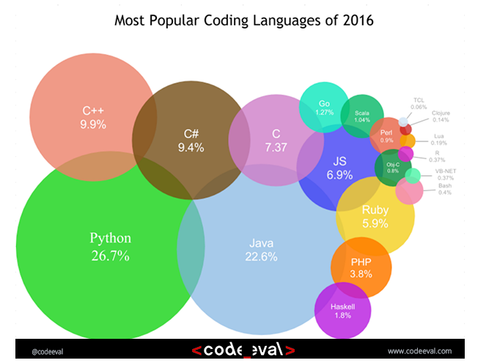
Programming 101

Slide 17
Programming 101
Why so many languages?
New features
Ease of use
Specific applications
Specific focus
Notes:
New features
Things that you used to have to do by hand are now abstracted away
Security
Drawing
Ease of use
Less instructions to accomplish same thing
More clear coding styles
Specific applications
The exercise drawing language
Power plants
Finance
Specific focus
Security
Speed
Big data

Slide 18
Programming 101
Language >>> Framework >>> Library
Frameworks
Typically an open source collection of open source libraries
Provide baseline of functionality for a given goal
Libraries
All of the code to accomplish the described task
Hide details of implementations, just give you functionality
Can be updated and benefits magically flow through
Allow others to use your solution to a problem
Notes:
Languages have frameworks which have libraries

Slide 19
Programming 101
Frameworks (Language)
Ruby On Rails (Ruby)
Laravel (PHP)
Twitter Bootstrap (CSS)
Angular (JS)
Libraries (Language)
jQuery (JS)
D3.js (JS)
SASS (CSS)
LINQ (C#)

Slide 20
Programming 101
Types of Applications
Static Web Sites
Dynamic Web Sites
Native Applications (Phones – multiple platform choices)
Native Applications (Desktops – multiple platform choices)
Everything else
Notes:
Overview the types, don’t get into details though - Breakdown on the next slides!

Slide 21
Programming 101
Web Site vs Web App
Static
No action will change the site
Every person who goes there will see the same thing
Dynamic
Changes depending on the user
User actions have responses and results
Likely requires a database to store the state
Notes:
State is the representation of all the stored information, at a given instant in time, to which the program has access

Slide 22
Programming 101
Web App vs Native Mobile App
Browser doesn’t get access to everything the phone can do
Browser is slower
Native app will only work on that phone’s platform

Slide 23

Programming 101
?

Slide 24
Servers Vs Browsers
Static Files
Server Code
Database
JavaScript
HTML
CSS
Web Server
User’s Machine

Slide 25
Servers Vs Browsers

Slide 26
Servers Vs Browsers
Static Files
Server Code
Database
JavaScript
HTML
CSS
Web Server
User’s Machine

Slide 27
Servers Vs Browsers
Type www.google.com -> Press Enter -> GET Request
Notes:
It all begins with the request
4 Different types which we’ll discuss later, but
Point is that when you hit enter in the url bar, you’re triggering what is going to be the first of many requests just to load a single webpage
https://www.google.com/imgres?imgurl=http%3A%2F%2Fimage.slidesharecdn.com%2Fenterpriserestpresov06-140815064459-phpapp01%2F95%2Fenterprise-rest-11-638.jpg%3Fcb%3D1408105530&imgrefurl=http%3A%2F%2Fwww.slideshare.net%2Fganeshcprasad%2Fenterprise-rest&docid=BIJf_p1Zm-VcwM&tbnid=XP6BueYBu06BCM%3A&w=638&h=479&ei=LfftVtaAH4P0jgTo04uYDA

Slide 28
Servers Vs Browsers
Static Files
Server Code
Database
JavaScript
HTML
CSS
Web Server
User’s Machine

Slide 29
Servers Vs Browsers
Static Files
Server Code
Database
JavaScript
HTML
CSS
Web Server
User’s Machine
Notes:
Pieces that run on the user’s machine

Slide 30
Servers Vs Browsers
Static Files
Server Code
Database
JavaScript
HTML
CSS
Web Server
User’s Machine
Notes:
Collection of elements and content that are going to be displayed on your website

Slide 31
Servers Vs Browsers
Static Files
Server Code
Database
JavaScript
HTML
CSS
Web Server
User’s Machine
Notes:
Client Side Logic
User pushes a button, says now do this
Triggers requests that don’t require a full page refresh
AJAX (Asynchronous JavaScript and XML)

Slide 32
Servers Vs Browsers
Static Files
Server Code
Database
JavaScript
HTML
CSS
Web Server
User’s Machine
Notes:
Describes the look
Any animations

Slide 33
Servers Vs Browsers
?

Slide 34
Servers Vs Browsers
Static Files
Server Code
Database
JavaScript
HTML
CSS
Web Server
User’s Machine
Notes:
Server Side

Slide 35
Servers Vs Browsers
Static Files
Server Code
Database
JavaScript
HTML
CSS
Web Server
User’s Machine
Notes:
Things like image files, javascript files, things that won’t change no matter who is accessing the site or what they’re trying to do

Slide 36
Servers Vs Browsers
Static Files
Server Code
Database
JavaScript
HTML
CSS
Web Server
User’s Machine
Notes:
Source of all user entered or automatically collected data
Relational vs non
Table vs Web
Implementations
MySQL (Relational)
PostgreSQL (Object-Relational)
Mongo (NoSQL)

Slide 37
Servers Vs Browsers
Static Files
Server Code
Database
JavaScript
HTML
CSS
Web Server
User’s Machine
Notes:
Server side logic
Validation and translation of client data
Action or inaction based on rules built to accomplish what the program is trying to do
Create, Update, Read, or Delete things on the DB
Languages
Node.js (Javascript)
C#
PHP
Ruby
Java
Python

Slide 38
Servers Vs Browsers
Static Files
Server Code
Database
JavaScript
HTML
CSS
Web Server
User’s Machine
Notes:
Review Front end vs back end roles and focuses

Slide 39
Servers Vs Browsers

Slide 40
Servers Vs Browsers
?

Slide 41
Process of Writing Code
Waterfall vs Agile
Spec To Wireframe To Implementation
Testing
Deploying
Making Choices
APIs
Secrets of Developers

Slide 42
Process of Writing Code
Waterfall
Very process oriented
One big, long journey of:
design -> build -> test -> release -> feedback
Agile
Customized to work however your team works best
Many tiny loops of:
design -> build -> test -> release -> feedback

Slide 43
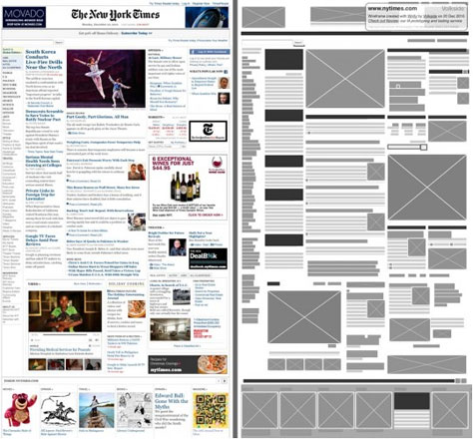
Process of Writing Code
Notes:
Start out being given a wireframe or design of what you need to create
Will have a spec documenting the required features and functionality of the thing to create

Slide 44
Process of Writing Code
Version Control
Stores state of the code
If things go wrong…
Allows for team-wide review and annotation of code
Common Providers: GitHub, BitBucket, VisualStudioOnline
Worst Case: Dropbox

Slide 45
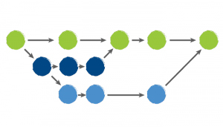
Process of Writing Code
Version Control
Branching
Thread of development
Copy of the code at a point in time
Multiple developers can work on same code at once
Merging
Brings branch of code back into the main flow’s state
Pull Request is opportunity to review
Forking
Copy of the code at a point in time
Usually when making major changes to someone else’s code
Notes:
Pull because you’re asking the owner of the main branch to “pull my changes into the main branch” if they think they’re correct
Hence why this is the point in time of reviewing
Fork -> io.js from nodejs.org and back into it

Slide 46
Process of Writing Code
Version Control
Sign up for a GitHub account
Install the client (https://desktop.github.com/)

Slide 47
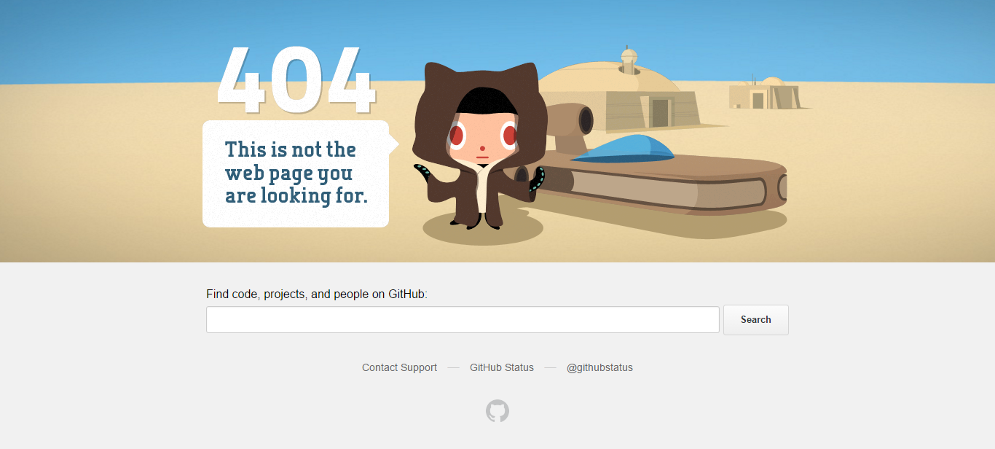
Process of Writing Code
Testing
Notes:
When things do go wrong, what happens?

Slide 48
Process of Writing Code
Testing
Make sure it works!
Manually
Automating with Code
End to End
Functional
Unit
Headless
Notes:
End to end tests are meant to check that a given application task completes from beginning to the end of the process without skipping any steps
Functional tests are meant to check individual pieces of code or functions
Unit tests are meant to check that a given piece of functionality works as expected
Headless tests are tests run in a browser without actually needing the browser, so buttons can be checked if they’re there and clicked and the results checked

Slide 49
Process of Writing Code
Deploying
Use a Cloud Provider
AWS / Azure / Google App Engine / Digital Ocean / etc.
Host it yourself
Continuous Integration / Deployment
Commit new code -> Run unit tests -> Allow code to be integrated
Commit new code -> New deploy to server
Commit new code -> Run unit tests -> (tests passed) New deploy

Slide 50
Process of Writing Code
Making Choices
Which Language?
Community engagement
Difficulty level
Development time
Front end or back end
Experience level
Which Host?
Cost
Speed
Geographic Needs
Support

Slide 51
Process of Writing Code
Making Choices
Which Browsers to Support?
Not all are “Standards” compliant
Older browsers don’t support newer features
Which Outside Services?
Error reporting
Usage gathering
APIs

Slide 52
Process of Writing Code
APIs
Contract between Supplier of data and Consumer
REST vs Non
Public vs Private
Popular APIs: Facebook, Twitter

Slide 53
Programming 102
Request Types
Get / Post / Put / Delete
Synchronous Vs Asynchronous
Response Codes
RESTful APIs
http://api.example.com/resources/
http://api.example.com/resources/item17
Notes:
REST = Representational state transfer
Collection, such as http://api.example.com/resources/
GET: List the URIs and perhaps other details of the collection's members.
PUT: Replace the entire collection with another collection.
POST: Create a new entry in the collection. The new entry's URI is assigned automatically and is usually returned by the operation.[16]
DELETE: Delete the entire collection.
Element, such as http://api.example.com/resources/item17
GET: Retrieve a representation of the addressed member of the collection, expressed in an appropriate Internet media type.
PUT: Replace the addressed member of the collection, or if it does not exist, create it.
POST: Not generally used. Treat the addressed member as a collection in its own right and create a new entry in it.[16]
DELETE: Delete the addressed member of the collection.

Slide 54
Process of Writing Code
Secrets of Developers
It’s way more Blood, Sweat, and Tears than it is Magic
Most only know a few languages
Only 1 or 2 extremely well
Learn basic programming concepts and patterns
They translate from language to language
When picking up a new language, allow for more focus on learning syntax and idiosyncrasies rather than everything
I use none of the programming languages I learned in college
I use the concepts, patterns, and problem solving techniques constantly

Slide 55
Process of Writing Code
Secrets of Developers
Best friend is Google
“Never memorize something that you can look up.” - Albert Einstein
Too many components and idiosyncrasies of each language
Good Programmers Copy, Great Programmers Steal
NEVER take code from the internet that you don’t understand
If no exact solution, find something similar, and adapt
Hardest part about programming is starting with a blank page
Notes:
Copy is copy and paste. Steal is taking the concept or how idea works / applied and being able to apply it to your situation.
Not making an exact copy of the slider that I found online, figuring out how theirs works and then using that as inspiration to build it how I need it built.

Slide 56
Process of Writing Code
?

Slide 57
Setting Up Your Development Environment
IDEs
Visual Studio
Eclipse
EMACS
Atom
Use Sublime Text or Download and Install Atom: https://atom.io/
Download and Install Chrome: https://www.google.com/chrome/browser/

Slide 58
Setting Up Your Development Environment
Create a folder structure like
PFNP
hello_world
images
css
js
http://bit.do/mikePFNP (must have correct case!)

Slide 59
HTML
Tag Structure
<tag name> contents </tag name>
<h1>Hello!</h1>

Slide 60
HTML
As Basic of a Page’s Structure As Possible
<html>
<head>
All of the page’s metadata
</head>
<body>
All of the page’s contents
<body>
</html>

Slide 61
HTML
Hello World!
<html>
<head>
<title>This is my very first website!</title>
</head>
<body>
<h1>Hello World!</h1>
<body>
</html>
Notes:
Let’s do it!

Slide 62
HTML
Layout Tags
Div
<div></div>
Contains things
Likely to be the most common element on pages
Defaults to being the width of the parent
Span
<span></span>
Defaults to being the width of the content

Slide 63
HTML
Content Tags
Headings
<h1></h1> through <h5></h5>
Paragraphs
<p></p>
Horizontal Rules
<hr/>
Line Break
<br/>

Slide 64
HTML
Content Tags
Bold
<b></b>
<strong></strong>
Italics
<i></i>
<em></em>

Slide 65
HTML
Content Tags
Ordered (numbered) Lists
<ol>
<li></li>
…
<li></li>
</ol>
Unordered (bulleted) Lists
<ul>
<li></li>
…
<li></li>
</ul>

Slide 66
HTML
Images
<img src=“sleeping_baby.jpg”/>
<img src=“folder/names/sleeping_baby.jpg”/>
<img src=“/folder/names/sleeping_baby.jpg”/>
<img src=“http://www.google.com/folder/names/sleeping_baby.jpg”/>

Slide 67
HTML
Links
<a href=“https://google.com” >Click Me To Go To Google</a>
target=“_blank” vs target=“_self”

Slide 68
HTML
Forms
Single Line Text Input Field
<input />
Multiple Line Text Input Field
<textarea></textarea>

Slide 69
HTML
Forms
Radio Buttons
<input type="radio" name="gender" value="male">
<input type="radio" name="gender" value="female">
<input type="radio" name="gender" value="other">
Check Boxes
<input type=“checkbox" name="gender" value="male">
<input type=" checkbox " name="gender" value="female">
<input type=" checkbox " name="gender" value="other">

Slide 70
HTML
Forms
Select Options
<select name="select">
<option value="value1">Value 1</option>
<option value="value2" selected>Value 2</option>
</select>
Multiple Select Options
<select name="select“ multiple>
<option value="value1">Value 1</option>
<option value="value2" selected>Value 2</option>
</select>

Slide 71
HTML
IDs
id=“thisIsMyName”
Can only be used on 1 element on a page
Way to target that single thing
Classes
class=“className1 className2 className3”
Same class can be applied to as many elements as desired
Way to target all elements that need the same thing applied

Slide 72
HTML
?

Slide 73
HTML
Let’s Update The Hello World Site!
Add an italic line (hint <em>)
Add an input for someone to type into
Add an ID to at least 1 element
Add a class to at least 1 element
http://bit.do/mikePFNP

Slide 74
CSS
How the content looks, not the content
Display this like this
This should be this size
All things like this should be this color
selector {
property: value;
property: value;
}

Slide 75
CSS
Selectors
Element
div { background-color: red }
ID
#thisIsMyId { height: 500px }
Class
.thisIsMyClass { width: 100px }
Position In Document
div .class1 p { color: blue }

Slide 76
CSS
Different Properties that can be Set
Too many to memorize or list - Google is your friend
Working with Colors
Name: red, blue, green, etc
Hexadecimal: #FF000
RGB: rgb(255,0,0)
RGBA: rgba(255,0,0,1)

Slide 77
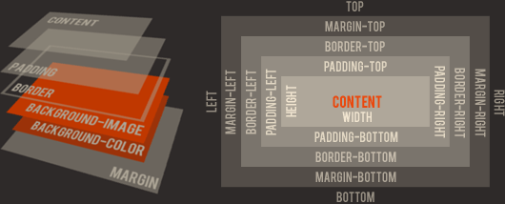
CSS
Box Model

Slide 78
CSS
?

Slide 79
CSS
Let’s Spruce Up Our Hello World Site!
Add a site.css file to your css folder
Add it to your index.html’s <head>
<link rel=“stylesheet” href=“css/site.css”>
Change the font color
Make the text underlined
Add a background image
Do a random thing
http://bit.do/mikePFNP

Slide 80
Let’s Build A Website!
The “Spec”
Create a blog of your favorite foods or entrees
Each dish must have:
Name
Image
Rating
Link to restaurant where it’s served
Sidebar with links to other resources

Slide 81
Let’s Build A Website!
Create a Wireframe
https://webdemo.balsamiq.com/

Slide 82
Let’s Build A Website!
Build It!
Create a blog of your favorite foods or entrees
Each dish must have:
Name
Image
Rating
Link to restaurant where it’s served
Sidebar with links to other resources
http://bit.do/mikePFNP

Slide 83
Let’s Build A Website! (Part 2)
The “Spec”
Create a personal site for yourself

Slide 84
Let’s Build A Website! (Part 2)
Build It!

Slide 85
Let’s Build A Website!
?

Slide 86
Recap
Programming 101
Servers Vs Browsers
Process of Writing Code
HTML
CSS
Build a Website

Slide 87
Programming 101
Programs are ordered sets of Instructions to accomplish a task
Open toy chest
Pick up toys
Put toys in toy chest
Open hamper
Pick up clothes
Put clothes in hamper
And so on…
Pick up toys
Put toys in toy chest
Pick up clothes
Put clothes in hamper
Make bed

Slide 88
Servers Vs Browsers
Static Files
Server Code
Database
JavaScript
HTML
CSS
Web Server
User’s Machine

Slide 89
Process of Writing Code

Slide 90
HTML
<html>
<head>
<title>This is my very first website!</title>
</head>
<body>
<h1 id=“page-heading”>Hello World!</h1>
<img class=“a-border” src=“folder/names/sleeping_baby.jpg”/>
<a href=“https://google.com” >Click Me To Go To Google</a>
<body>
</html>

Slide 91
CSS
Box Model

Slide 92
Recap
Any last questions?
See you tomorrow!

